Slide 1

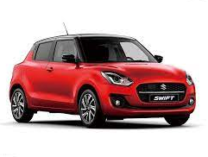
Prediction Model For Car Price
Major Project Presentation
Group Id :- C4

Slide 2

Group Members
19102A0037
Yash Patil
19102A0051
Omkar Jalgaonkar
19102B0049
Amey Thorat
Payas Patel
20102B2007

Slide 3
Content
Introduction
Literature Survey
Proposed System
Flow Chart
Software Used
Library Used
Working Model
Future Scope

Slide 4
Introduction
The focus of this project is developing machine learning models that can accurately predict the price of a used car based on its features, in order to make informed purchases.
We implement and evaluate various learning methods on a dataset consisting of the sale prices of different makes and models.
Depending on various parameters we will determine the price of the car. Regression Algorithms are used because they provide us with continuous value as an output and not a categorized value because of which it will be possible to predict the actual price a car rather than the price range of a car.

Slide 5
Literature Survey
The first paper is Predicting the price of Used Car Using Machine Learning Techniques. In this paper, they investigate the application of supervised machine learning techniques to predict the price of used cars in Mauritius. The predictions are based on historical data collected from daily newspapers. Different techniques like multiple linear regression analysis, k-nearest neighbours, naïve bayes and decision trees have been used to make the predictions.
The Second paper is Car Price Prediction Using Machine Learning Techniques. Considerable number of distinct attributes are examined for the reliable and accurate prediction. To build a model for predicting the price of used cars in Bosnia and Herzegovina, they have applied three machine learning techniques (Artificial Neural Network, Support Vector Machine and Random Forest).

Slide 6
Proposed System
We will first collect the data in csv format and then we will pre-process the data and clean the data and remake the cleaned data file in csv format.
Then will we start showing the relations of one attribute with others.
Then we will start testing and training the dataset which we have already made in the clean data set file.
Using linear regression model, we will make a pipeline and see the accuracy of the model.
And after that we will give the inputs required ie. Company name, model name, kilometres travelled, etc and predict the price of given car.

Slide 7
Flow Chart
Start
Data Collection
Importing Required Packages and Opening Data Set File
Creating Backup File and Data Pre Processing
Creating Cleaned Data Set File and Checking Relationship of attributes with each other
Training and Testing Data
Using Linear Regression Model Find Accuracy of Model
Predict the Price Of Car on Flask Web App
Stop
Display the Details of Car Webpage

Slide 8
Software Used
Python
PyCharm
Jupyter Notebook
Excel CSV
HTML, CSS, JavaScript
Flask

Slide 9
Library Used
Pandas
Seaborn
Sklearn and its Functions
Numpy
Matplotlib and its Functions
Pickle

Slide 10
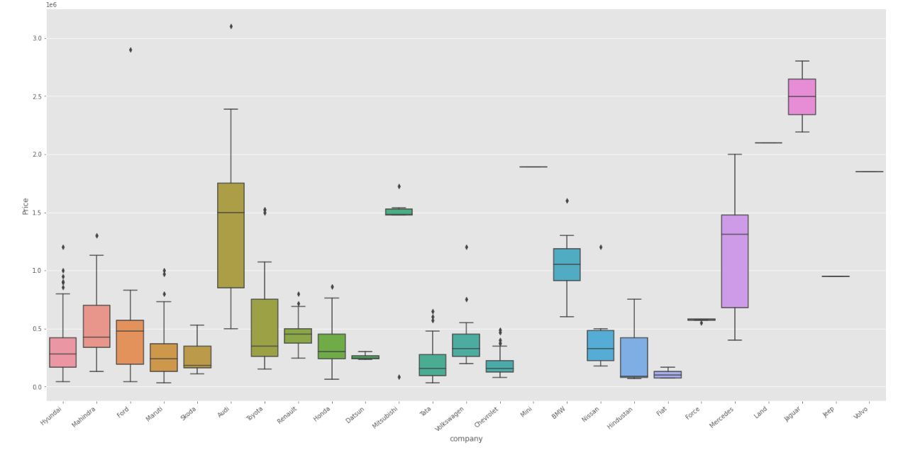
Working Model
Checking relationship of Company with Price

Slide 11
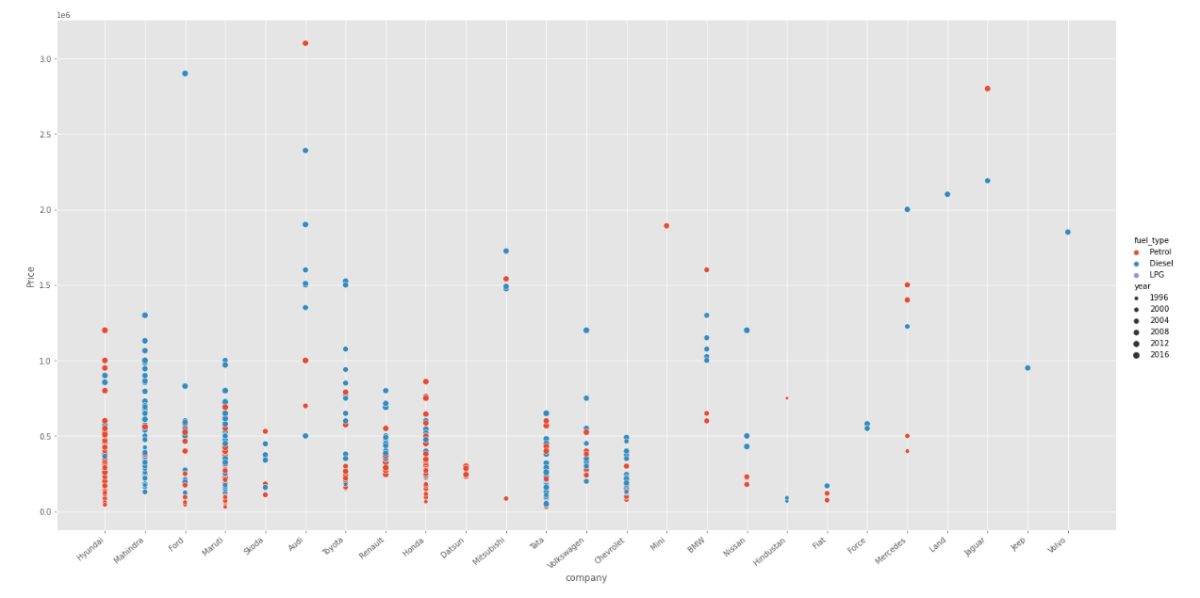
Relationship of Price with Fuel Type, Year and Company mixed

Slide 12
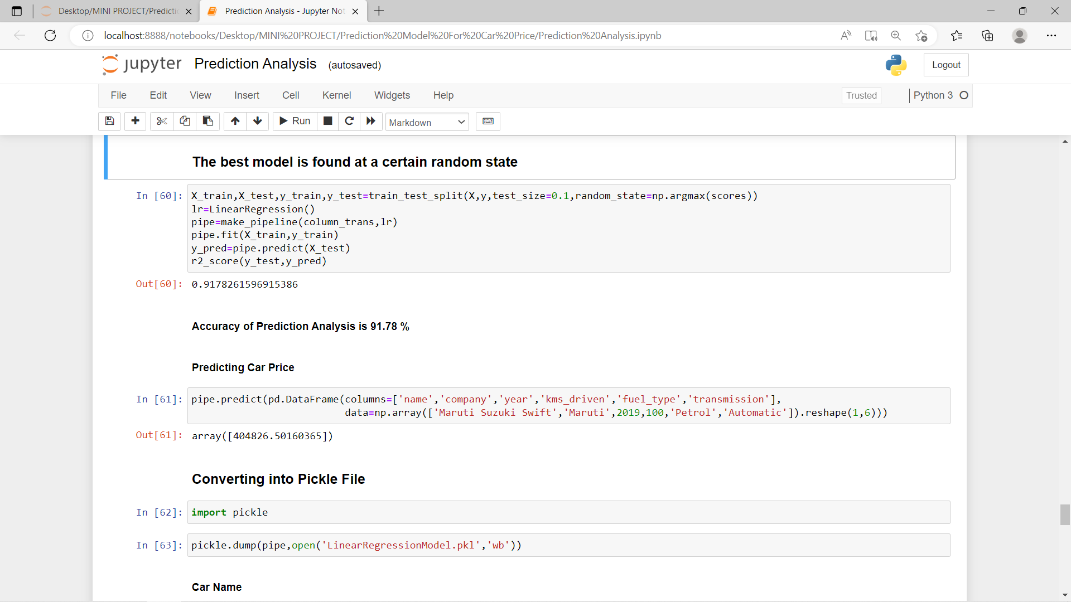

Slide 13
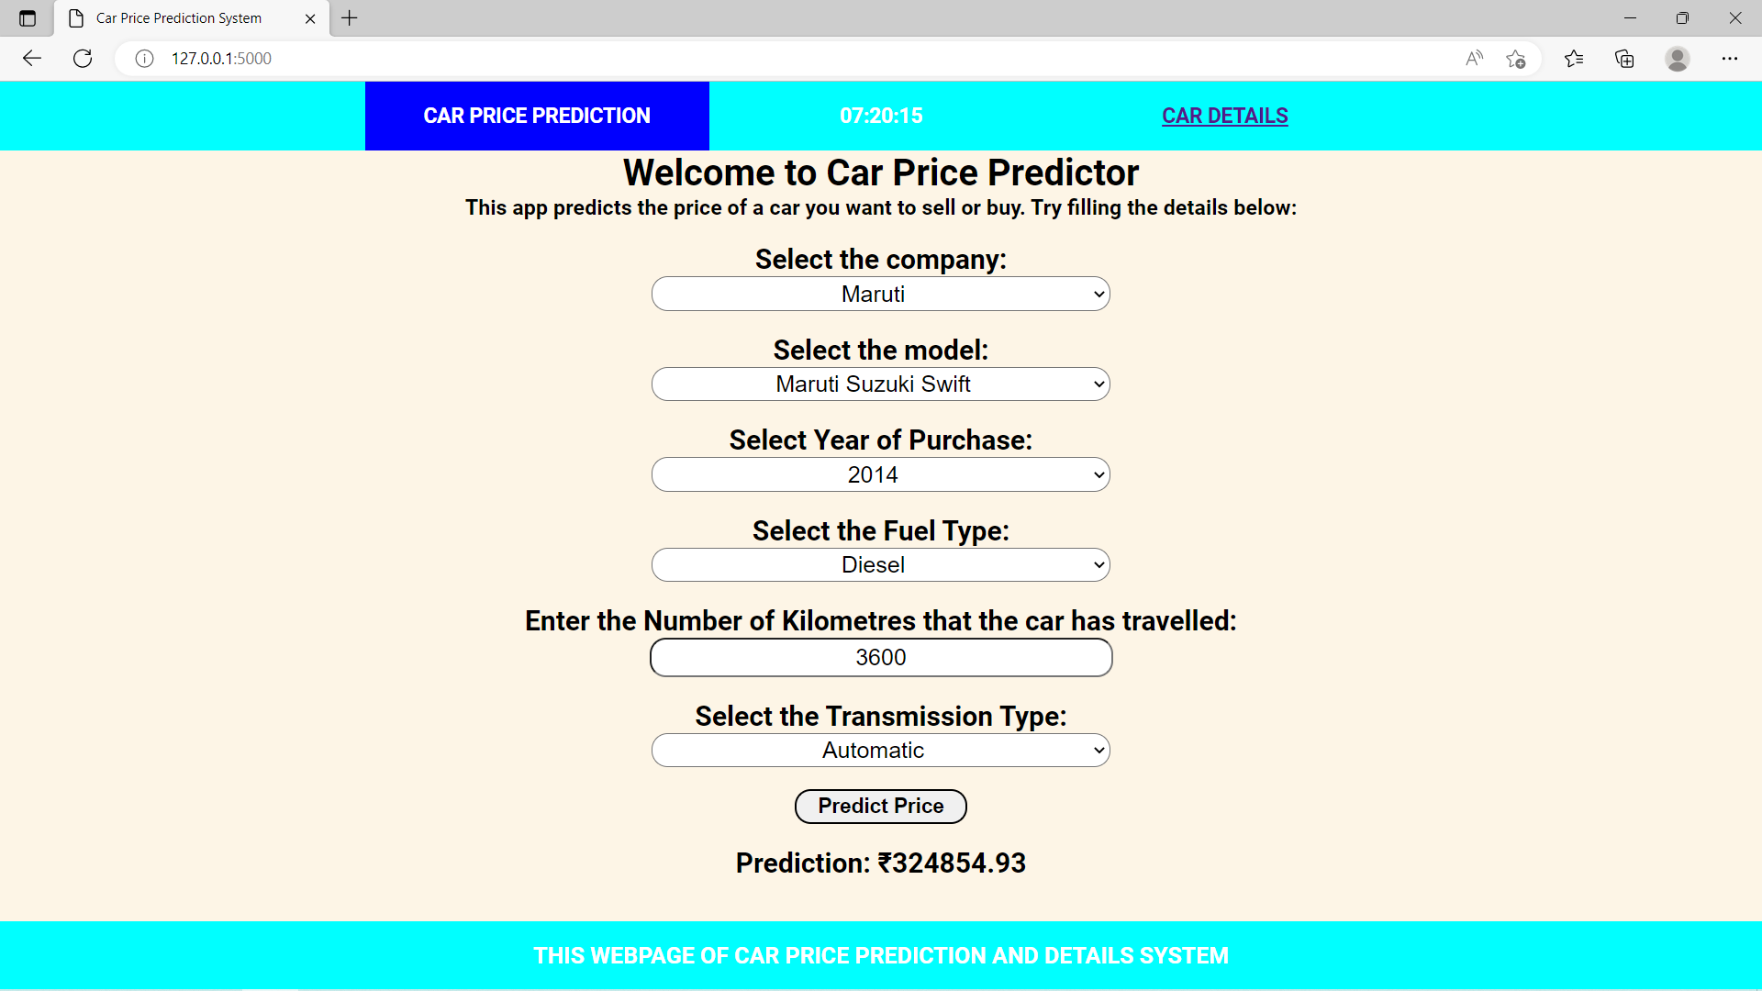
Prediction Page:

Slide 14
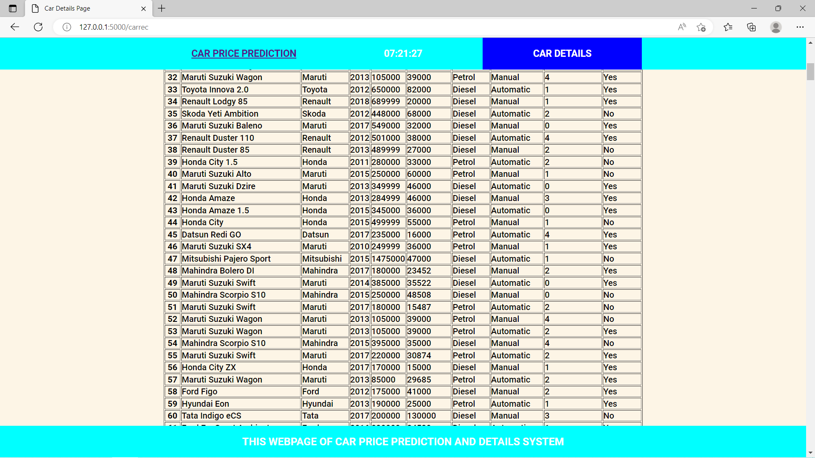
Details Page:

Slide 15
Future Scope
In future this machine learning model may bind with various website which can provide real time data for price prediction.
Also, we may add large historical data of car price which can help to improve accuracy of the machine learning model.
For better performance, we plan to judiciously design deep learning network structures, use adaptive learning rates and train on clusters of data rather than the whole dataset.
Also we may add the recommendation page where we have add only car model name and it will display the result related to it.
We can host this application on servers such as Heroku, etc.

Slide 16



Thank You For Your Attention

